Slide 1













DRAGON TALE
GROUP 6

Slide 2



Nguyen Duc Nguyen Phuc - ITDSIU21108
TEAM
MEMBERS
Le Huynh Nha Nguyen - ITDSIU21058
Phan Bao Tran - ITDSIU21125
Pham Trung Tin - ITDSIU19019

Slide 3


TABLE OF CONTENTS
1
4
INTRODUCTION
DEMO
2
5
METHODOLOGY
ACKNOWLEDGEMENTS
3
6
INSTALLATION
CONCLUSION

Slide 4






01
INTRODUCTION

Slide 5


THE PROJECT AIMS:
Develop a game that brings entertainment to players.
Applying Object-Oriented Programming techniques.
Go through the process of game management and enhancing the code.
Assess the potential for expanding the basic code by incorporating additional features.

Slide 6









USAGE TOOLS
DISCORD
PIXEL STUDIO
DRAW.IO
GITHUB
INTELLIJ

Slide 7
02
METHODOLOGY

Slide 8




GAME RULES
01
GAME AIMS
04
THE INTERACTIVE TO
02
BEGINNING PLAYER
05
PASSING STARTING POINT
06
PLAYER
03
THE PLAYER

Slide 9

GAME RULES
07
KEY
10
HATMONKEY AND SLUGGER
08
FIREBALL
FIRING AND SCRATCHING
11
09
ENEMIES
12
ARANIK

Slide 10


GAME RULES
13
BIRD
16
VENOM
COINS AND POINTS
14
HERO
17
BOSS
18
TELEPORT
15

Slide 11
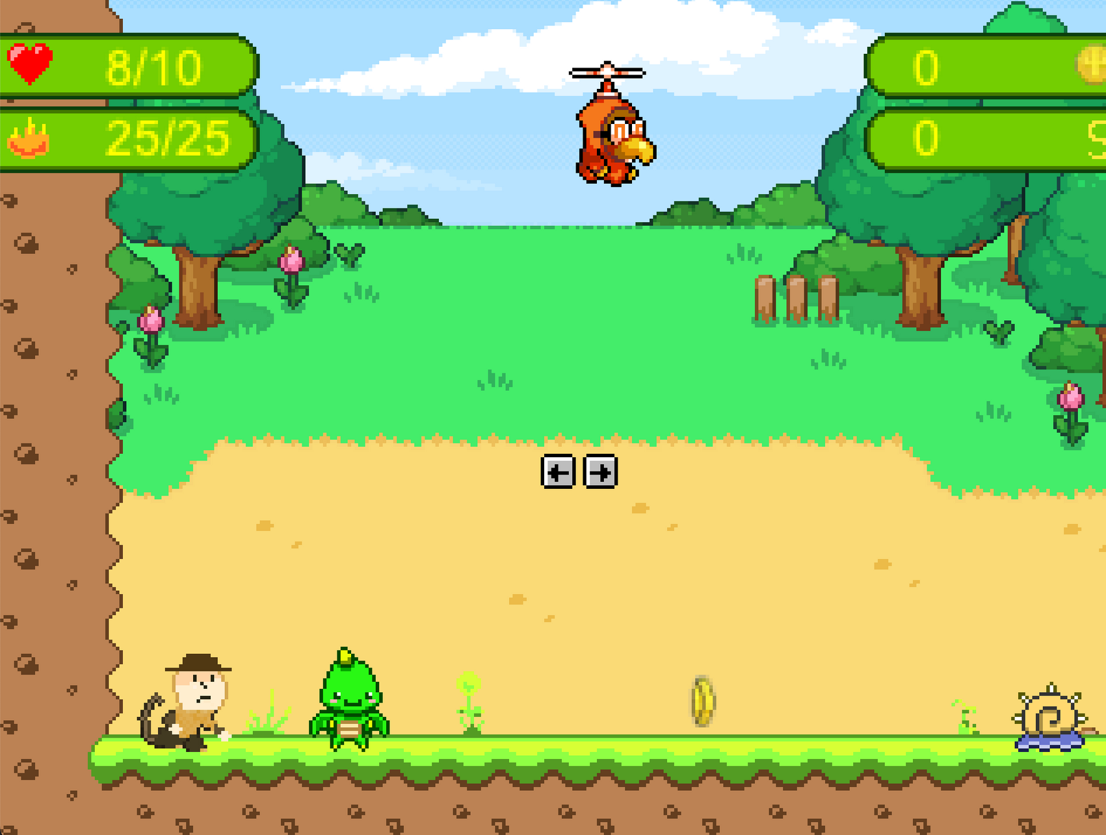
THE DESIGN
Main Screen
Player

Slide 12


THE DESIGN
Slugger
Bird
HatMonkey
Arachnik
Hero
Boss

Slide 13




THE DESIGN
Health
FireBall
Coin
Point

Slide 14

CONTROL THE CHARACTER
Action
Key
Run
Jump
W
Scratching
R
Firing
F
Fly
W + E

Slide 15
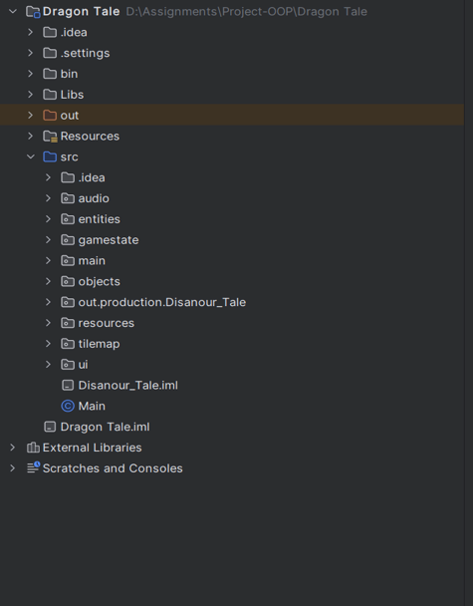
ALGORITHM

Slide 16
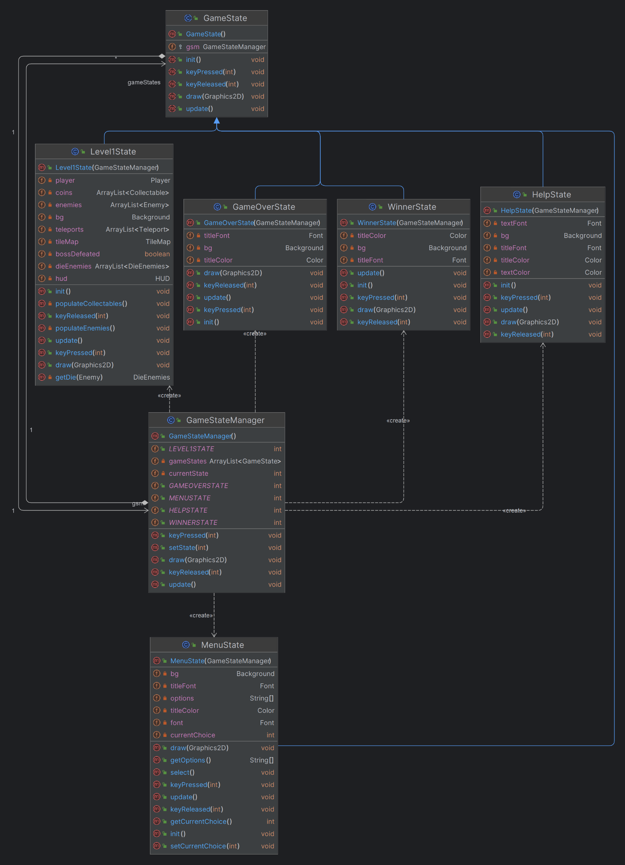
UML DIAGRAM

Slide 17
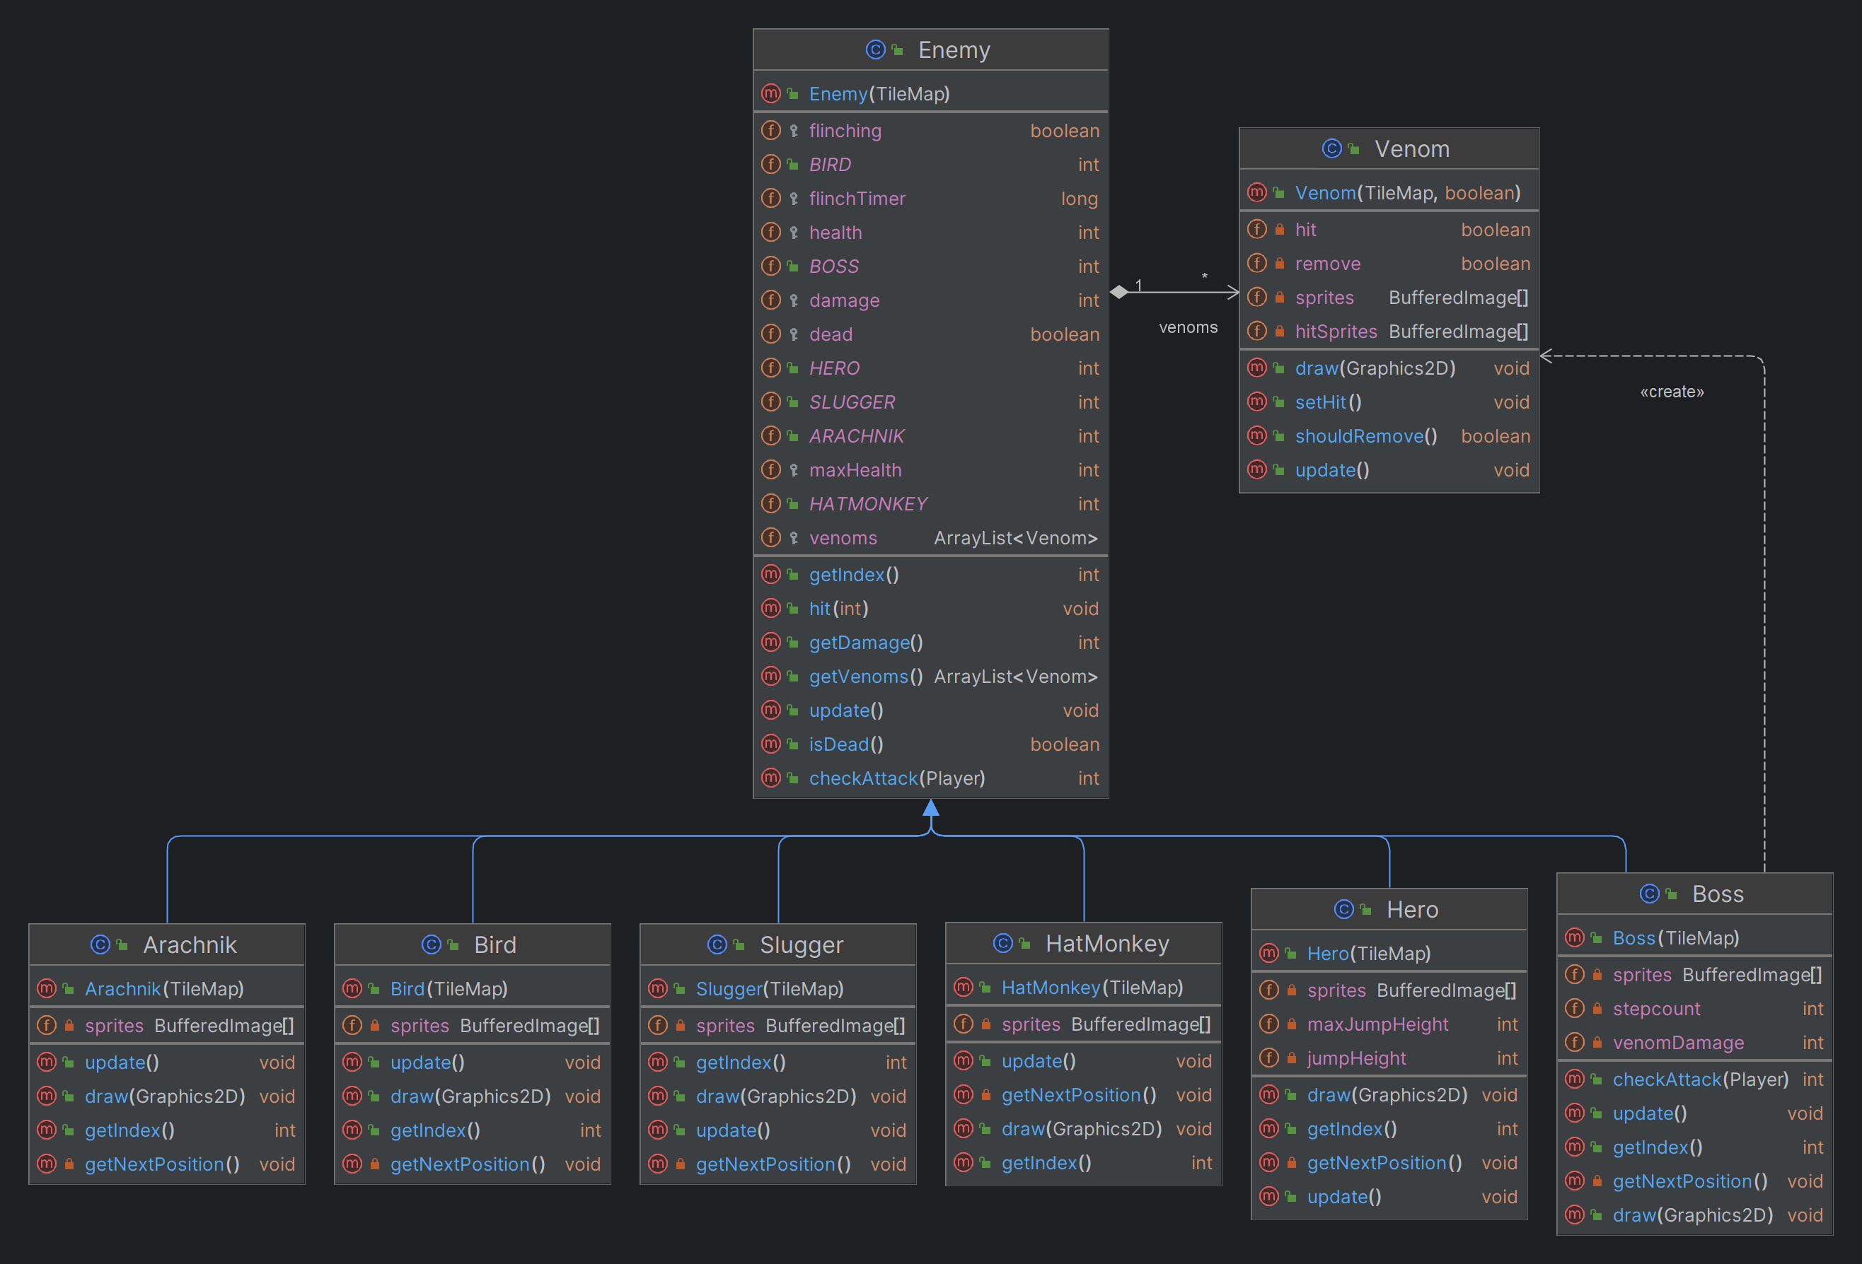
UML DIAGRAM

Slide 18
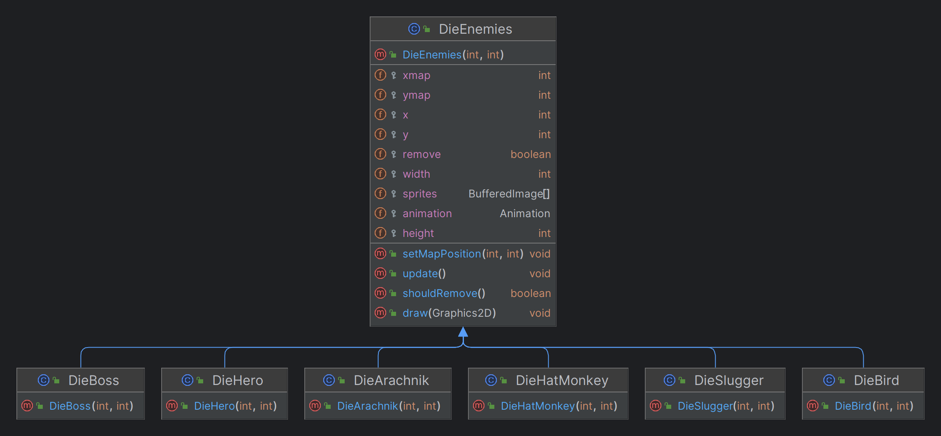
UML DIAGRAM

Slide 19
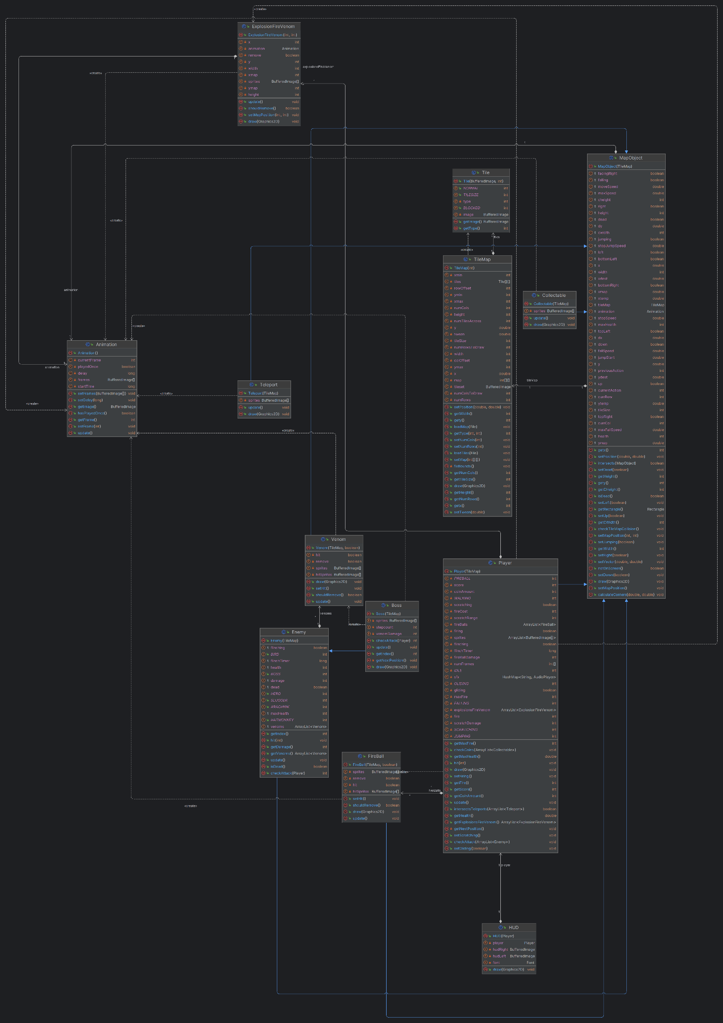
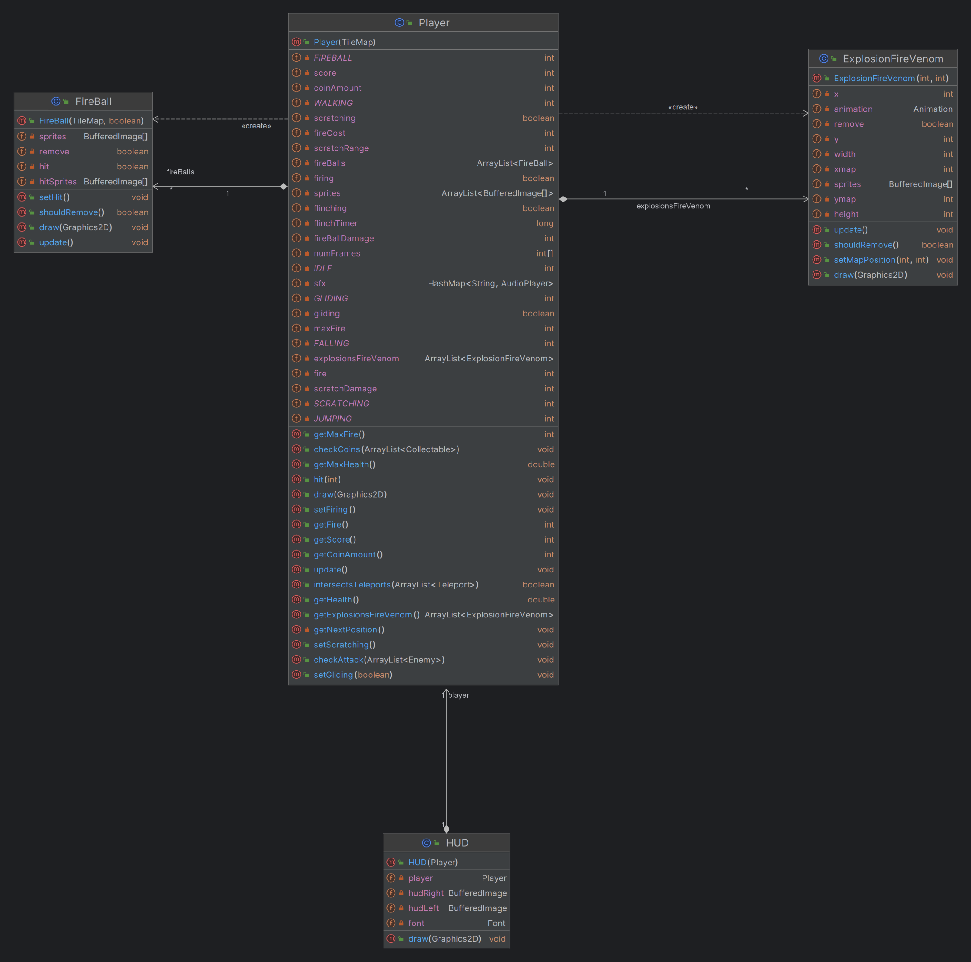
UML DIAGRAM

Slide 20
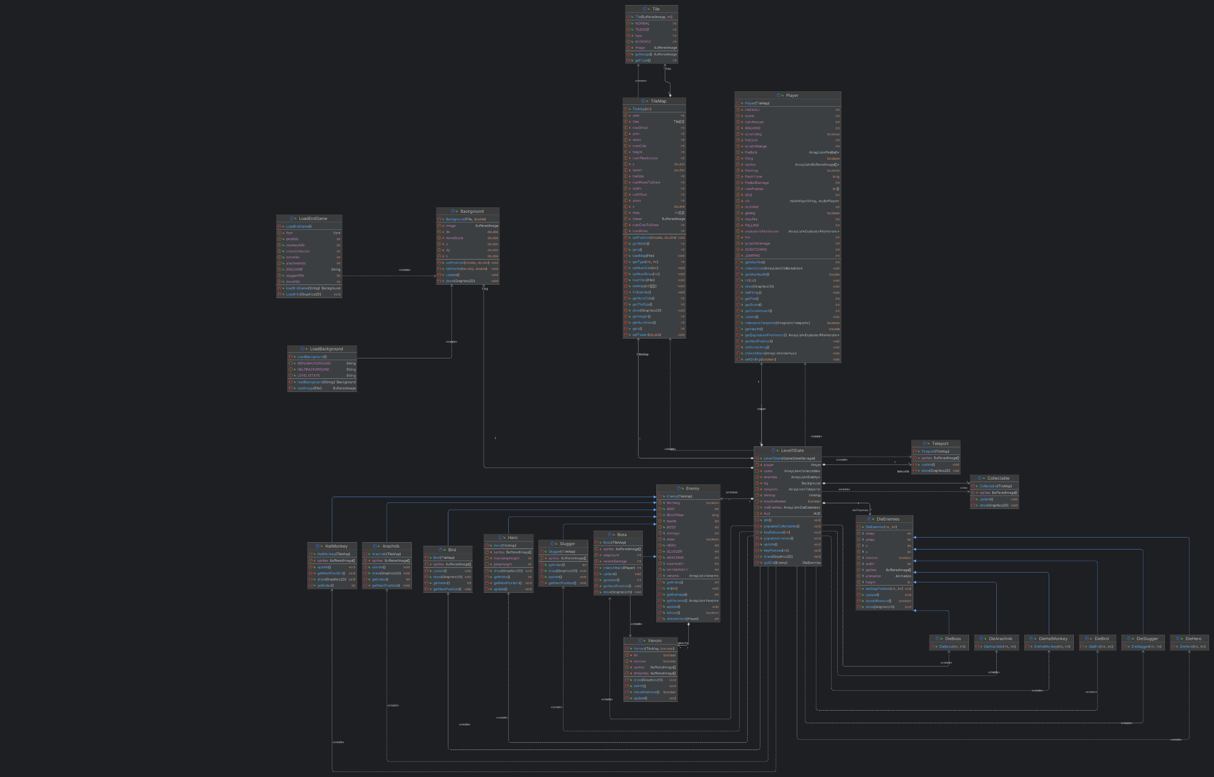
UML DIAGRAM

Slide 21
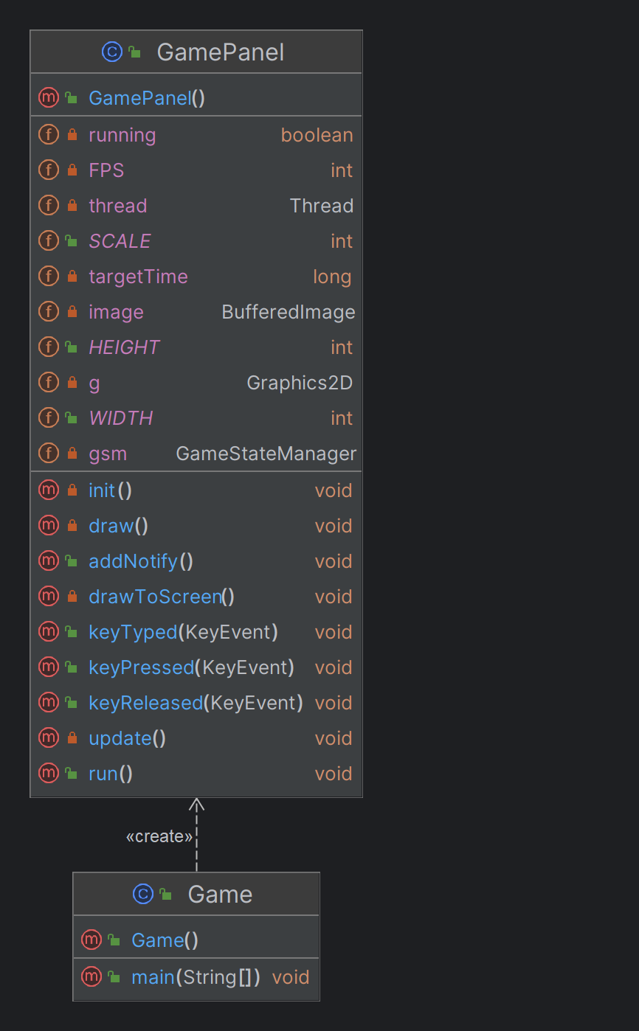
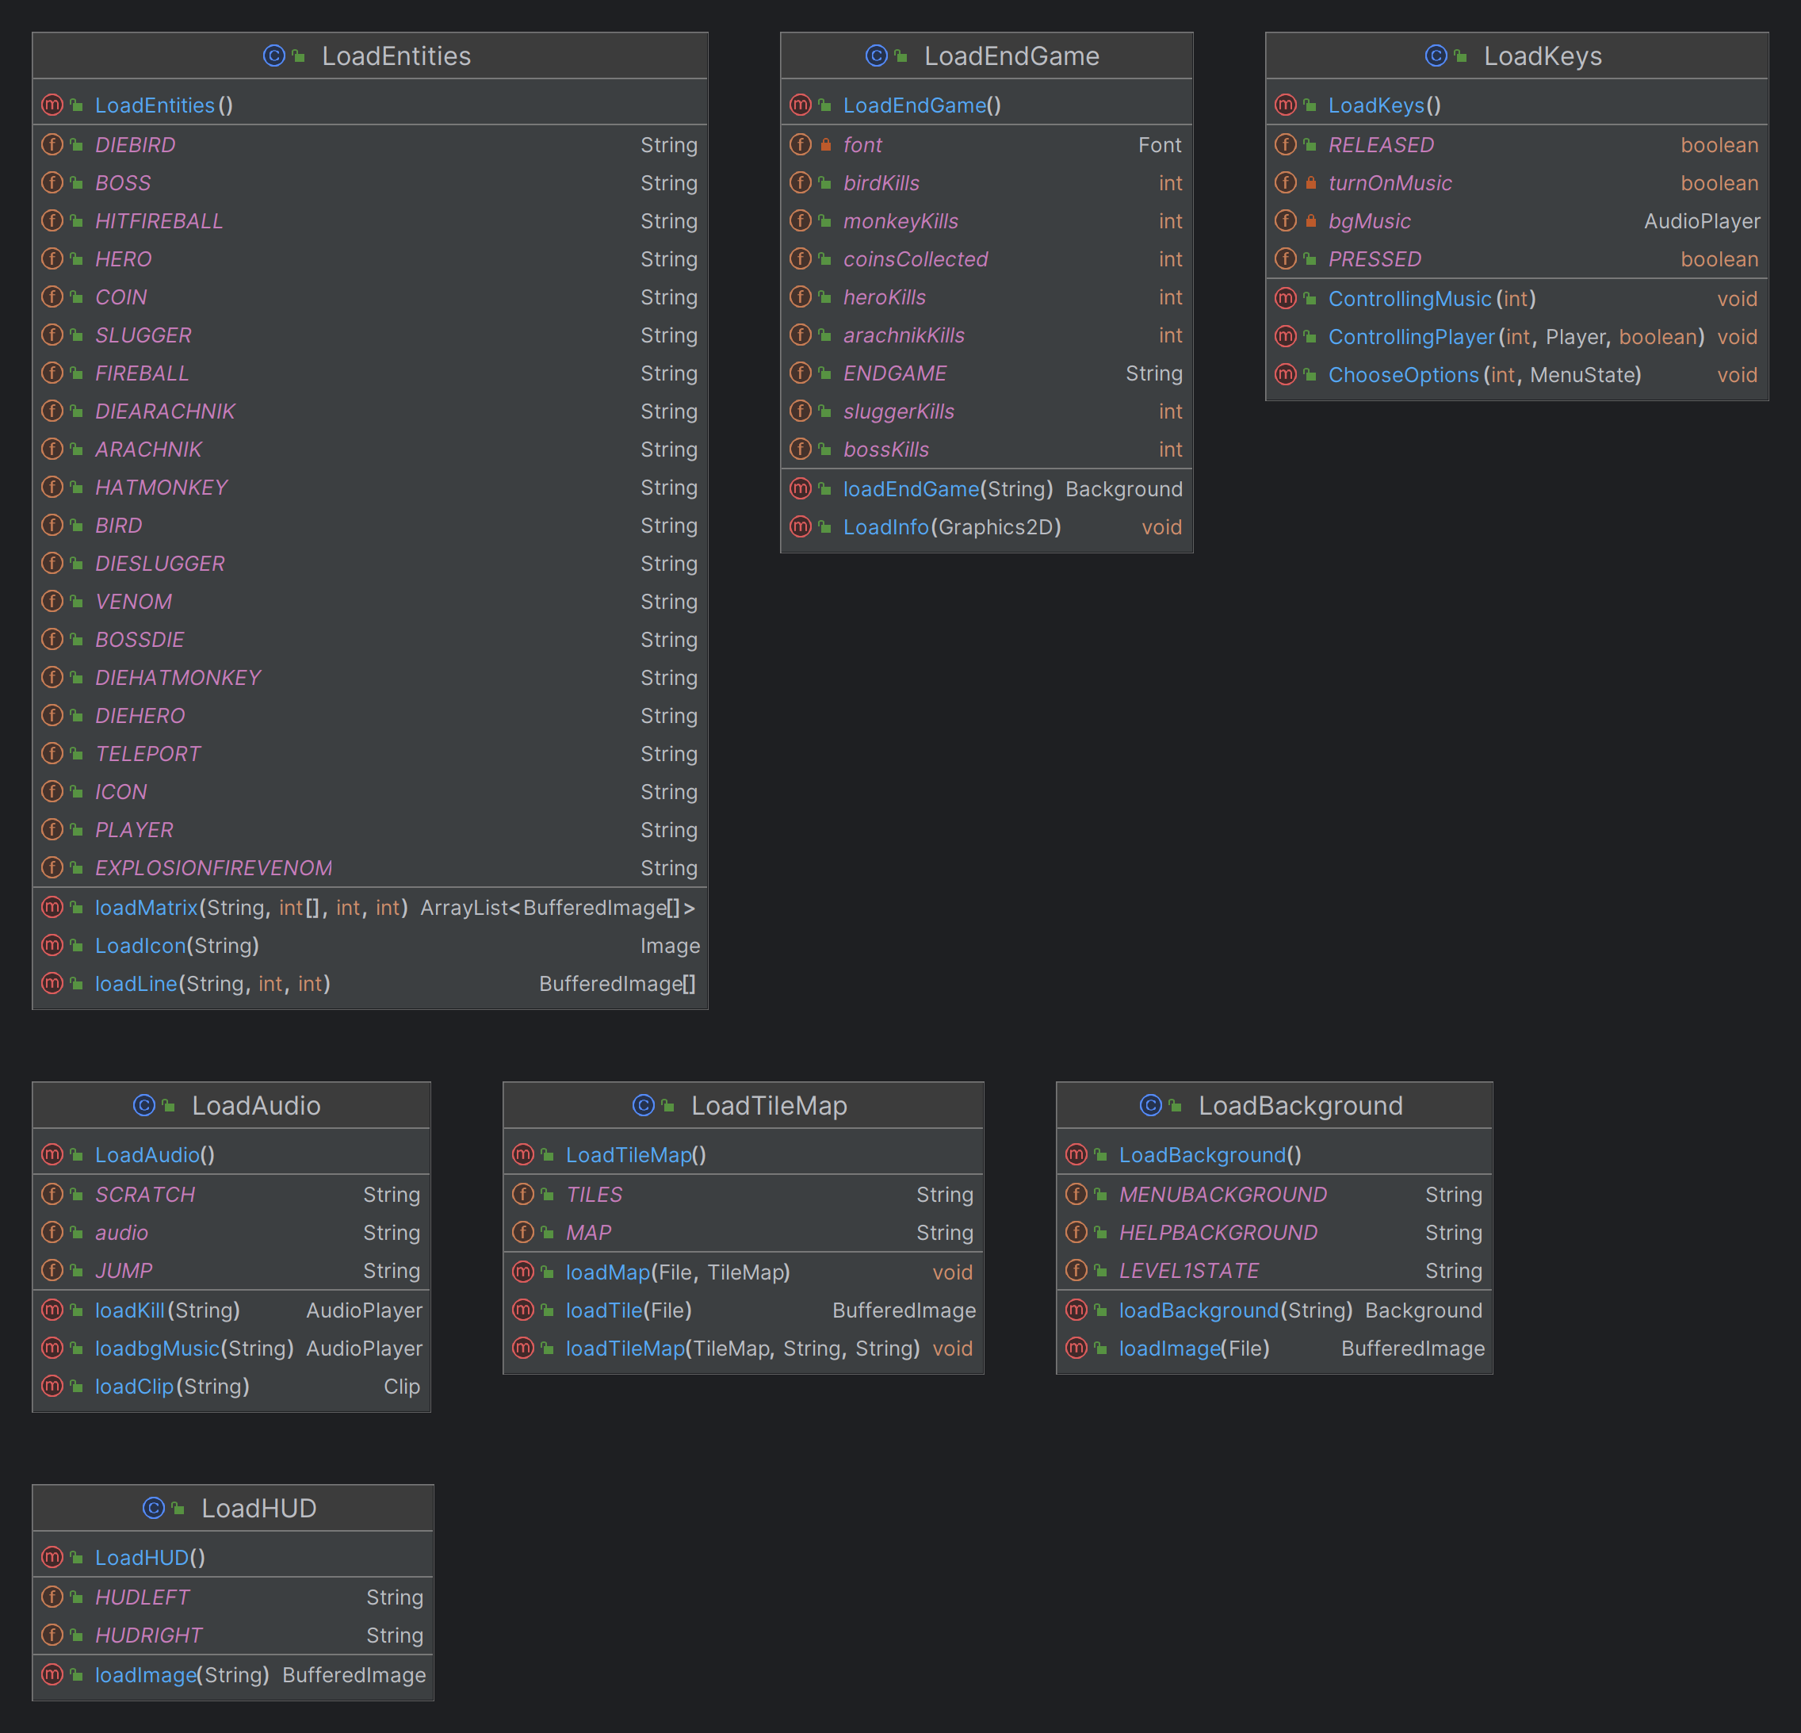
UML DIAGRAM

Slide 22





03
INSTALLATION

Slide 23





04
DEMO

Slide 24

05
ACKNOWLEDGEMENTS

Slide 25


DEEPEST appreciation
Dr Tran Thanh Tung
MSc Nguyen Quang Phu
Original code from foreign guymike
The sites Geeksforgeeks, Javapoints, and so on
The README.md template from othneildrew

Slide 26
06
CONCLUSION

Slide 27


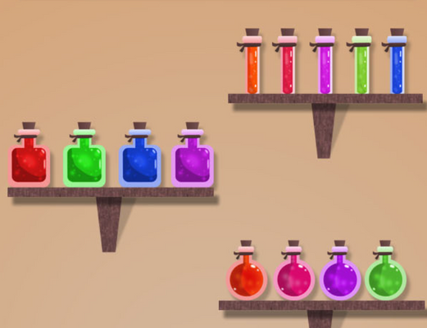
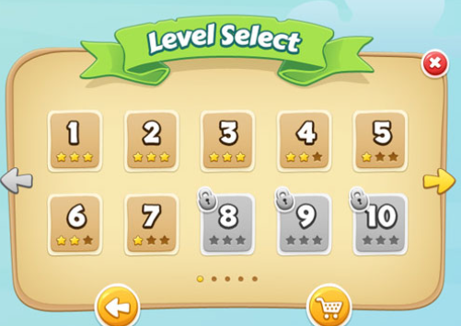
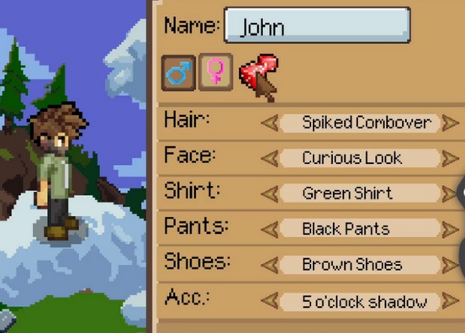
FUTURE ROADMAP
Power-up items
Additional levels
Customize characters

Slide 28
REFERENCES
[1] ForeignGuyMike. (2018). foreignguymike/dragontale [Java]. Retrieved December 10, 2023, from https://github.com/foreignguymike/legacyYTtutorials/tree/master/dragontale
[2] Java Swing Tutorial. Javatpoint. (n.d.). Retrieved December 11, 2023, from
https://www.javatpoint.com/java-swing
[3] UML Diagrams Tutorial. Javatpoint. (n.d.). Retrieved January 4, 2023, from
https://www.javatpoint.com/uml-diagrams
[4] Drew, O. (2022). Othneildrew/Best-README-Template. Retrieved January 4, 2023, from
https://github.com/othneildrew/Best-README-Template
[5] SOLID Principle in Programming: Understand With Real Life Examples. GeeksforGeeks. Retrieved December 28, 2023, from
https://www.geeksforgeeks.org/solid-principle-in-programming-understand-with-real-life-examples/
[6] Playing music in a Java game. stackoverflow. Retrieved December 16, 2023, from
https://stackoverflow.com/questions/27854171/playing-music-in-a-java-game
[7] Ileriayo Adebiyi. (2020). Ileriayo/ markdown-badges. Retrieved January 4, 2023, from
https://github.com/Ileriayo/markdown-badges
[8] The Java™ Tutorials: Coordinates. Oracle. Retrieved December 10, 2023, from
https://docs.oracle.com/javase/tutorial/2d/overview/coordinate.html

Slide 29




THANK YOU FOR LISTENING!

